Slide 1
INTERFACING IR SENSOR AND RASPBERRY PI
GROUP 3
NIBIN SOBY
C0741660

Slide 2

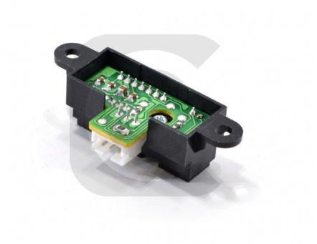
IR PROXIMITY SENSOR
IR Sensor which helps to measure accurate distance
It has a detection range of 4″ to 32″ (10 cm to 80 cm)
This sensor is very easy to use

Slide 3
SPECIFICATIONS
Dimensions :23.2mm × 12.5mm × 22 mm
Operating voltage : 4.8 V to 6V
Maximum Rotation :120 to 180 degree
Speed : 0.10sec/60 degree
Torque : 1.5kg*cm

Slide 4
USE IN OUR PROJECT
IR sensor will be placed in the bin to detect the height up to which the garbage is filled
It will helps to detect the level where garbage is filled and thus notify

Slide 5
INTERFACING –OBJECTIVE
Components Used
Raspberry pi
IR Proximity sensor
Buzzer
LED
Here I am trying to establish the communication between IR sensor and Raspberry Pi, and the interfacing can be indicated by a LED and a Buzzer.

Slide 6
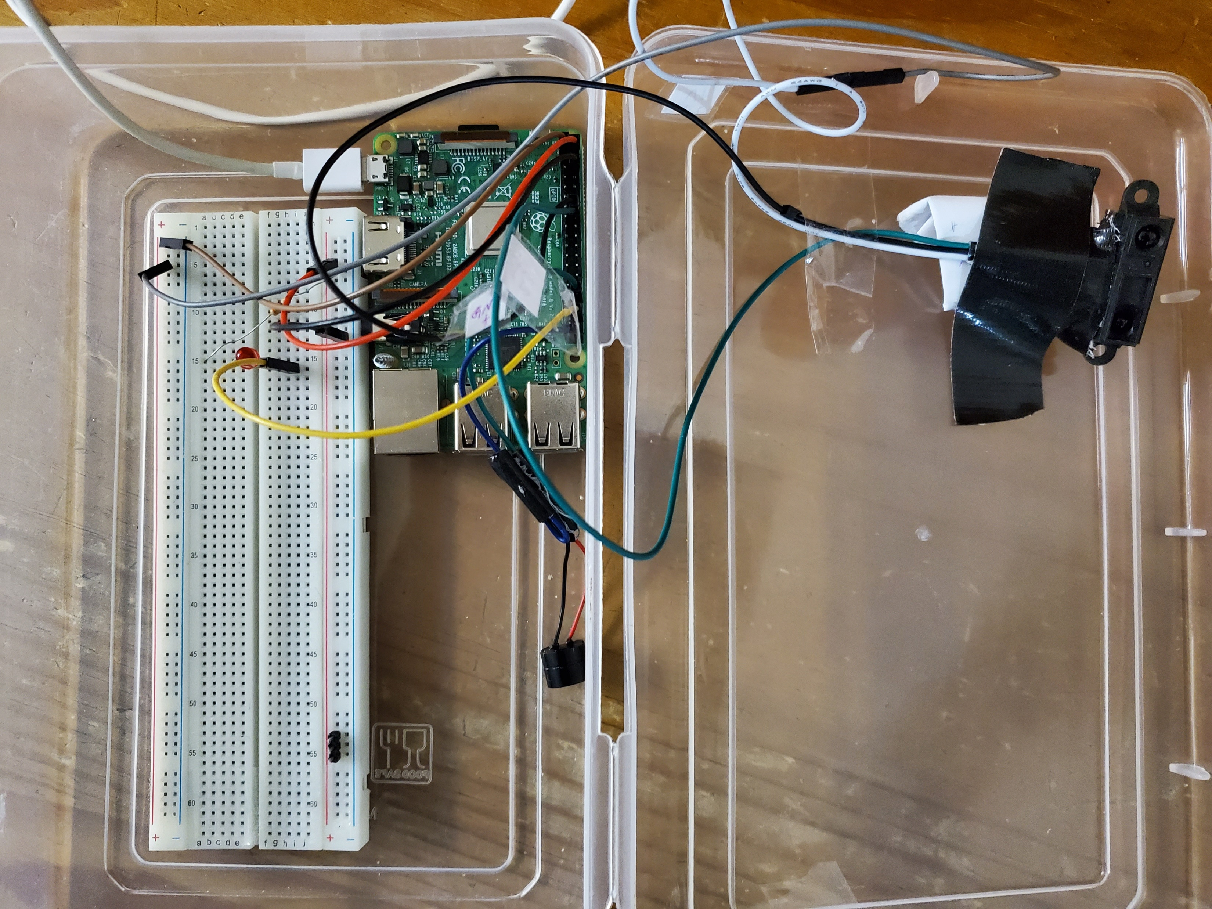
CONNECTION
IR Sensor And Raspberry Pi
VCC Connected to 5v
Ground Connected to Ground
Vout is connected to GPIO 23
LED and Raspberry Pi
Pin 1 connected to Ground
Pin 2 connected to GPIO 16
Buzzer and Raspberry Pi
Pin 1 connected to ground
Pin 2 Connected to GPIO 12

Slide 7
Code
//Library functions//
#include <stdio.h>
#include <wiringPi.h>
#include <wiringPiI2C.h>
#include <fstream>
#include <iostream>
#include <thread>
#include <chrono>
//Initializing hardware components//
const int led = 16;
const int proximity = 23;
const int buzzer = 12;
uint8_t LastStatus = 1;
uint8_t EmergencyStop= 21;

Slide 8
Code
int main(void)
{
wiringPiSetupGpio();
pinMode(led, OUTPUT);
pinMode(buzzer, OUTPUT);
pullUpDnControl(proximity,PUD_DOWN); //pullupdown control for IR Sensor
pullUpDnControl(EmergencyStop,PUD_DOWN); //Pullupdown control if there is an emergency stop is needed
for(int i=0; i<2; i++)
{
digitalWrite(buzzer, HIGH);
digitalWrite(led, HIGH);
delay(100);
digitalWrite(led, LOW);
digitalWrite(buzzer, LOW);
delay(100);
}

Slide 9
Code
while(1)
{
if(digitalRead(proximity) && LastStatus==0) // when there is an obstacle
{
digitalWrite(led, HIGH);
digitalWrite(buzzer, HIGH);
LastStatus = 1; //updating last status
}
else if(!digitalRead(proximity) && LastStatus==1)
{
digitalWrite(led, LOW);
digitalWrite(buzzer, LOW);
LastStatus = 0;
}

Slide 10
Code
if(digitalRead(EmergencyStop))
{
break;
}
}// end of while loop
}

Slide 11
Steps
Hardware connection are made
Connection to raspberry pi is established and Raspbian os is launched using VNC viewer
Code has been written in Geany in Raspbian,and saved the code as IR_sensor.c
Then Code has been compiled and executed in terminal
COMPILING CODE
pi@raspberrypi:~ $ g++-9.1 -std=c++17 -Wall -pedantic -lwiringPi IR_sensor.c -o IR_sensor
EXECUTING CODE
pi@raspberrypi:~ sudo $ ./ IR_sensor

Slide 12
Results
The code has been compiled and executed successfully in terminal
The LED and Buzzer made indications according to the change in the distance between the obstacle and IR sensor
Thus the Interfacing between the IR sensor and Accelerometer has been made Sucessfully.

Slide 13
Video Link:
https://www.youtube.com/watch?v=ou0a85eKptY&feature=youtu.be
GitHub link :
https://github.com/NibinSoby/Main-project-IR-sensor/blob/master/IR_sensor.c

Slide 14
REFERENCE
https://www.creatroninc.com/product/gp2y0a41sk0f-ir-proximity-sensor-4-to-30cm/
https://www.raspberrypi.org/forums/viewtopic.php?t=177161
http://iot.pcsalt.com/detecting-obstacle-with-ir-infrared-sensor-raspberry-pi-3/
https://www.raspberrypi.org/products/raspberry-pi-3-model-b/

